Slide 1
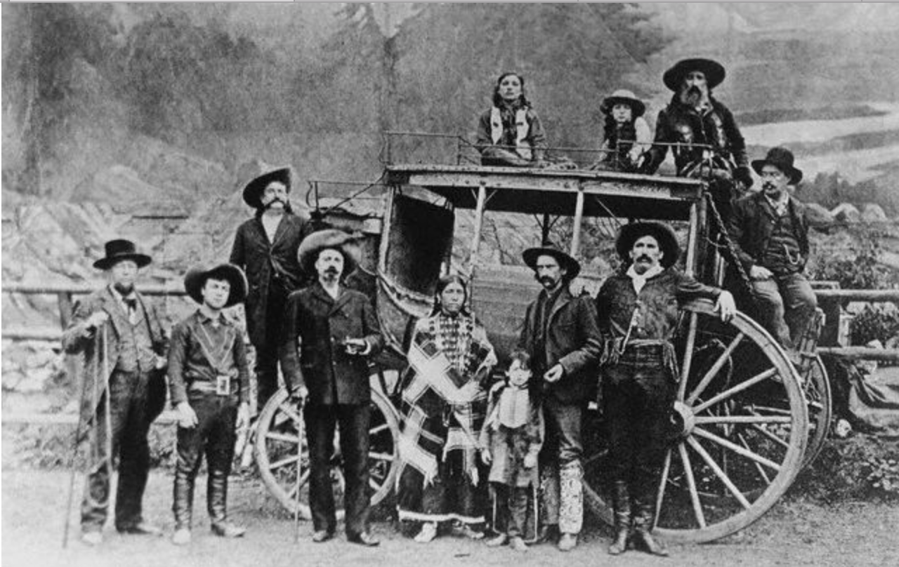
Ethereum Smart Contracts
Welcome the the wild west!
Perth Ethereum Meetup 8th April 2017

Slide 2
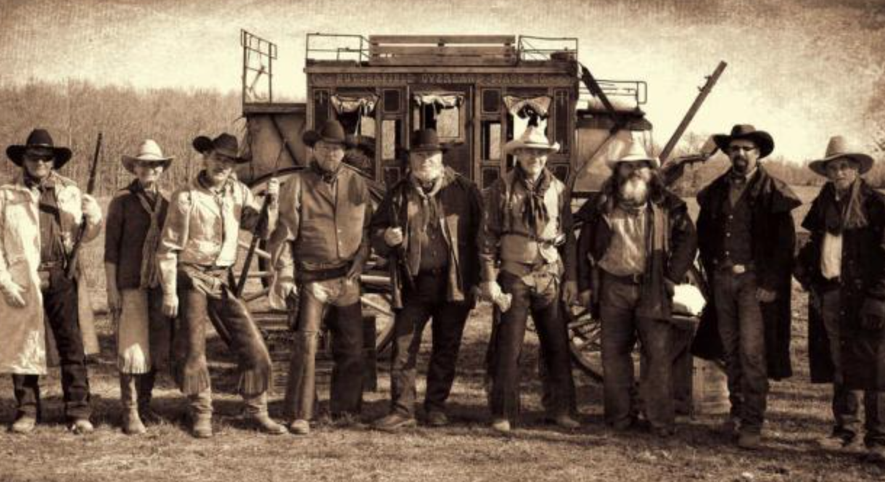
First things first…..
This is a Hands-On Lab, you ready for the rodeo?
Ethereum Client
Mist
Visual Studio Code (or another text editor)
Internet Access
Agenda
Some background terms and a how it all works
Some real world examples
Lets shoot from the hip and build a few contracts

Slide 3

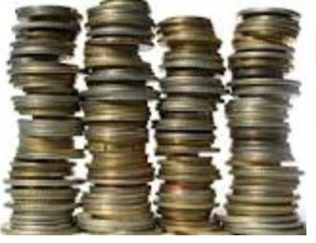
What is a block chain? Some basics.
Distributed Database of processing nodes aka “Miners”
First record is called the “Genesis block”
Transactions are recorded in ‘Blocks’ by Miners
Everyone (or majority) need to agree
Blocks are then cryptographically ‘signed’
Everything repeats
Results in a unchangeable/incorruptible Ledger
Miner B
Miner A
Miner C
Miner D
Genesis block
######
Block
#2
######
Block
#3
######
Block
#4
######

Slide 4
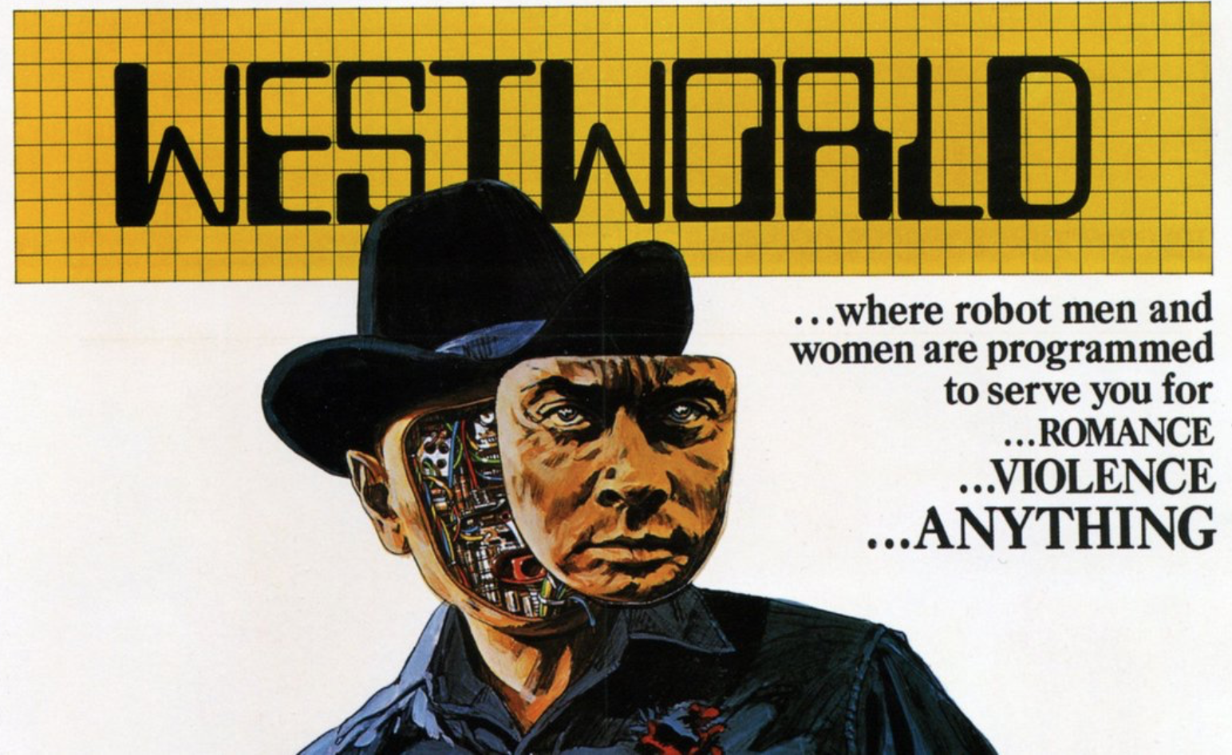
What is a Smart Contract?
Set of processing instructions that
Can be accessed by anyone
Use modified “Merkle Patricia Trees” to hold state and interact with Blockchain assets
Runs on every miner node
(for the moment anyway)
Can operate on separate “cousin” blockchains
Can act as a “trusted” third party
Code does not lie or cheat (yet)
Code can be open sourced, checked and audited.. by humans or automation!
Contract byte code can be “verified” against the blockchain address to ensure what is supposed to happen, will happen.
Miner get paid by “Gas” which is a transaction fee charged “per line”, currently fixed at 0.00001 Ether, but that will change.

Slide 5

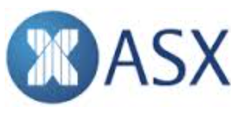






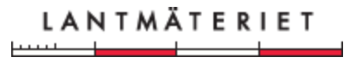
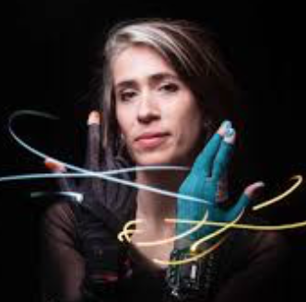
Some real world examples .. Unfortunately most are just rumours and experiments
FINANCIAL / COMMERCIAL SERVICES
GOVERNMENT / CIVIL
ENTERTAINMENT / SOCIAL
Blockchain Tech
Probably not Ethereum
WARNING: Smoke and mirrors section…
The DAO
Various services
Bill-of-lading
Autonomous
Record Keeping
Honduras
Ghana
Food distribution
and Supply chain
Swedish Land Registry
NOTE: The US SEC have rejected the Winklevoss Bitcoin Trust because bitcoin markets are mostly unregulated and unable to enter into surveillance-sharing agreements. 15th March The Australian Business Review,
Imogen Heap
Royalty control

Slide 6

What can you expect? … Hombre!

Slide 7

“You see, in this world there's two kinds of people, my friend: Those with loaded guns and those who dig. You dig”.
Immutable, Irrevocable….. (‘ish)
Code can act as a true trusted third party.
Contracts can hold tokens or Ether in escrow; or check the balance of others accounts to ensure payment can be made.
Transparency in all things
Can run in separate private chains or fully public
Solidity is considered “Turning Complete”, i.e. it can solve basic problems. Solves “Halting Problem” by using gas limits.
Allows for democracy and voting
Always available, always on …

Slide 8

“Oh I almost forgot. He gave me a thousand. I think his idea was that I kill you.
But you know the pity is when I'm paid, I always follow my job through. You know that..”
Your smart contract is NOT smart and NOT a contract! It’s just code that updates a ledger.
Your contract is merciless and programmers make mistakes
You can’t have consensus for anything outside of the Blockchain
It’s not a good option for peer-to-peer insurance (yet?)
Gas price will need to be market driven rather than fixed to Ether price
Lots of questions around scaling to a global level

Slide 9

“I'm looking for the owner of that horse. He's tall, blonde, he smokes a cigar, and he's a pig!”
Technology is very young, so the tools are limited.
There has been a “Hard-fork” after disputes.
Not tied to any particular nation state or regulator. So how the law will deal with a stateless funds is an open question.
A lot of overly hyped start-ups and prototypes out there.
Contract Addresses can’t change; but that’s mitigated somewhat with Ethereum Name Service

Slide 10
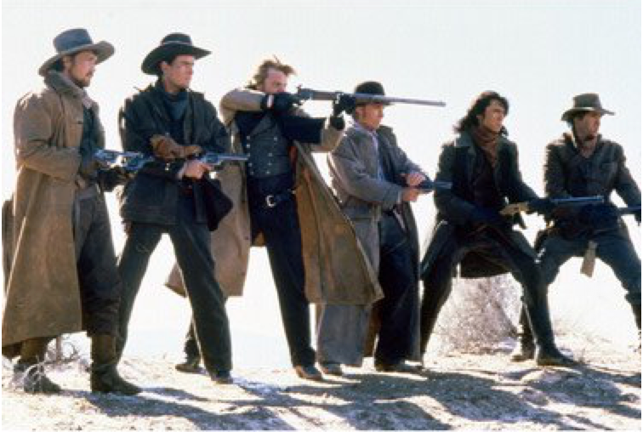
Ok Young Guns; let’s round up the posse for code!

